Slide 1
Human Impact on Trees and Forests

Slide 2
Humans…
We as humans, can either enhance or threaten the trees and forests based on what we choose to do.
For example:

Slide 3
ENHANCE
Planting new trees to replace the dead or cut down trees
Having controlled fires so that new trees can grow
National Parks
OTHER IDEAS?

Slide 4
Threaten
Destroying forests for new homes
Logging
Recreation
OTHERS IDEAS?

Slide 5
Draw a table like the one below into your notes
Forest | ENHANCE | THREATEN
1. 2. 3.

Slide 6
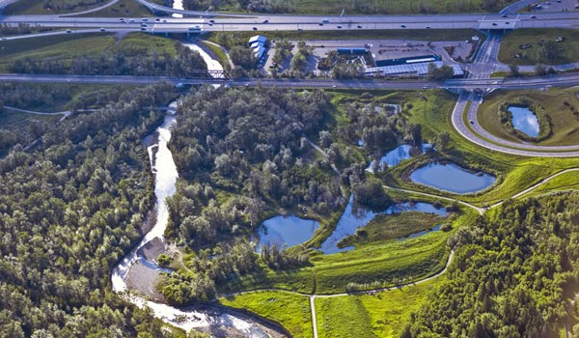
Fish Creek Park

Slide 7
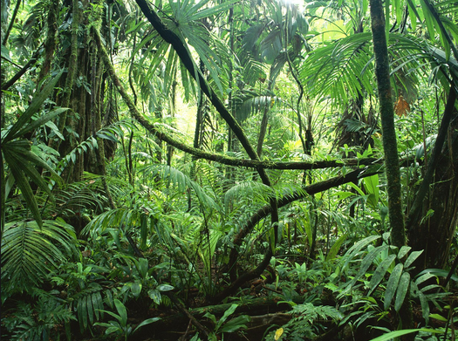
Brazilian Rainforest

Slide 8
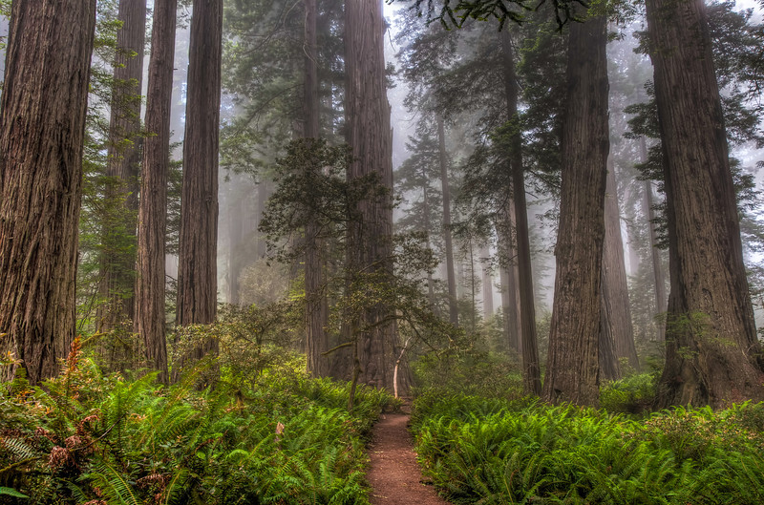
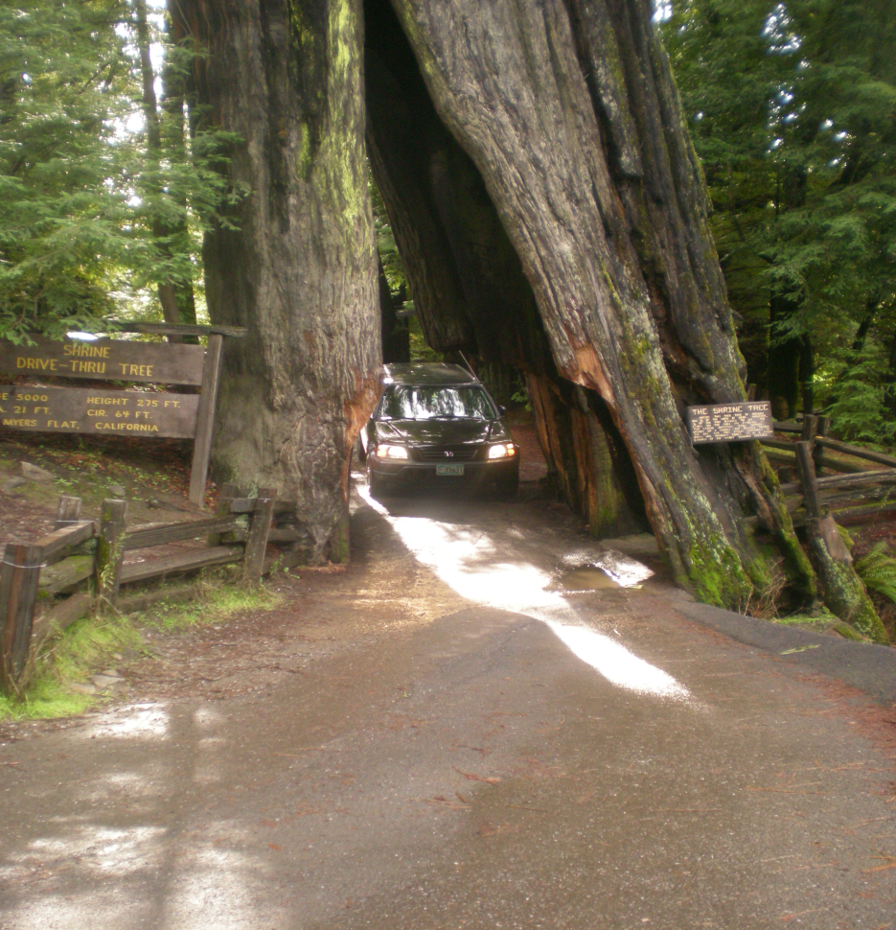
Redwood Forest

Slide 9
Perspectives when dealing with trees and forests

Slide 10
Jumbo Glacier Ski Resort
Controversial new ski resort is in the process of being built in the Kootenay area of SE British Columbia.
Jumbo Glacier is planned to be a year-round skiing mountain resort developed in three phases at an estimated cost of $450 million. The future resort development has been the subject of controversy as a result of public opposition from the residents of the region, the Lower Kootenay First Nation and the and Sinixt Nation for political, economic, and environmental reasons

Slide 11
A Couple videos
https://www.youtube.com/watch?v=1-cjZBaxLf0
http://www.washingtonexaminer.com/b-c-approves-jumbo-glacier-mountain-ski-resort/video/gm-4933410

Slide 12
Current events and perspectives
It is your job in project manager teams to develop a stance on whether this ski resort is a good idea or whether the BC government should put a stop to it.

Slide 13
Jumbo Glacier Ski Resort
TODAY: develop and gather ideas on your groups stance on the issue
Larger poster paper
Markers
ipad for research
Tuesday: more time to finish poster and develop what everyone will be saying.
→ Everybody in your group must contribute to the discussion (ie. Everyone must say something).
Wednesday:
Debate/ forum sharing the various groups thoughts and ideas

Slide 14
Assessment
Scientific events stem
Communication stem
Self/peer evaluation

Slide 15
Project Manager Teams
Canadian Parks and Wilderness Society (of BC)
Ski and snowboarder enthusiasts
The surrounding towns people
Tourism industry
First Nations
Surrounding ski resorts

Slide 16
Groups 6D
Canadian Parks and Wilderness Society (of BC): Eleena, Nick, Sam, Joelan
Ski and snowboarder enthusiasts: Bogdan, Sara, Jordan, Ryker
The surrounding towns people: Jessica, Emilia, Cam, Meagan
Tourism industry: Carter, Saul, Takira, Kat
First Nations: Fisayo, Ashley, Donish, Alyssa
Surrounding ski resorts: Mackenzie, Fancy, Rover, Ryan

Slide 17
Groups 6C
Canadian Parks and Wilderness Society (of BC): Clayton, Jayden, Nathan, Faz,
Ski and snowboarder enthusiasts: Hadyn, Kelly, Namid, Brooklyn
The surrounding towns people: Aya, Jarret, Niah, Logan, Owen
Tourism industry: Salma, Carla, Hirsi, Haley
First Nations: Bella, Shianne, Cody, AJ, Reiya
Surrounding ski resorts: Shawn, Laila, Austyn, Conner

