Slide 1
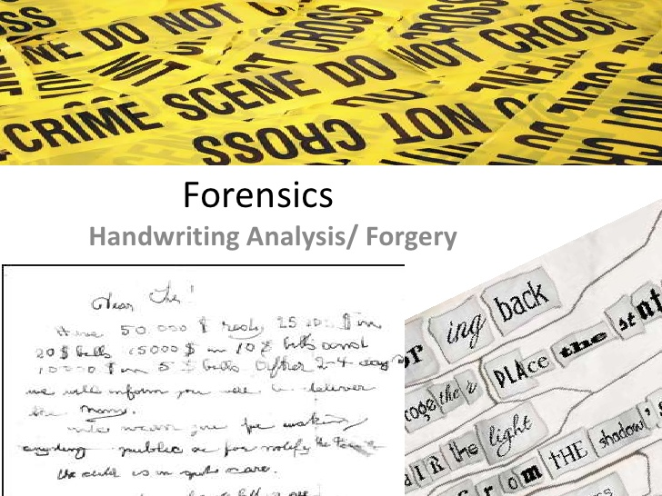

Slide 2
1. Handwriting Analysis
Graphology: Study of is the analysis of the physical characteristics and patterns of handwriting

Slide 3
Handwriting Analysis
You will receive two colors of paper and everyone gets the same writing utensil.
You will also need your science duo tang

Slide 4
What to do?
On the first sheet of paper please write #1 in the top corner.
You will be copying what it says in your everyday normal writing.

Slide 5
Write on your paper in one paragraph.. TWO MINUTES WILL BE TIMED
The quick brown fox jumped over the lazy dog. I am a student at David Thompson Middle School. I am in Ms. Smith’s class learning about different techniques scientists use to solve crimes. Today, I will learn about handwriting analysis and forgery. The quick brown fox jumped over the lazy dog.
Repeat 2 more times if you get done.

Slide 6
Page #2
Write a #2 in the top right corner of the next page of paper
On the second sheet of paper you will copy exactly what you wrote, but will try and alter your handwriting.

Slide 7
Scenario…
Ms. Goodfellow would like a writing sample from each student in the room. She has found several pieces of evidence of vandalism. A group of students have written on the bathroom stalls! The principle wants to find the guilty parties. Can she do this by comparing each student’s handwriting against the evidence?

Slide 8
What now?
If you were innocent… not problem. You’d just jot down whatever she wanted you to and give it to her; however, in this example you are GUILTY! You totally DID write on the bathroom stall and now you are worried about getting caught.
The only way out is to try and fool the principle by trying to change the way you write. She shows you a picture of what was written (THE FIRST PIECE OF PAPER) and asks you to re-write it in front of her.

Slide 9
Continued…
Scribbling is not allowed. Writing excessively large or small is not allowed. It needs to look like normal writing, otherwise your principle will know that you have something to hide and are guilty! Also, not stalling!
Try and chance your writing style and make it look like someone else’s true writing. The principle says you have 2 minutes to write the following…

Slide 10
What to write.
The quick brown fox jumped over the lazy dog. I am a student at David Thompson Middle School. I am in Ms. Smith’s class learning about different techniques scientists use to solve crimes. Today, I will learn about handwriting analysis and forgery. The quick brown fox jumped over the lazy dog.
Repeat 2 more times if you get done.
Once I say stop. Please print your first and last name in the bottom left of the page

Slide 11
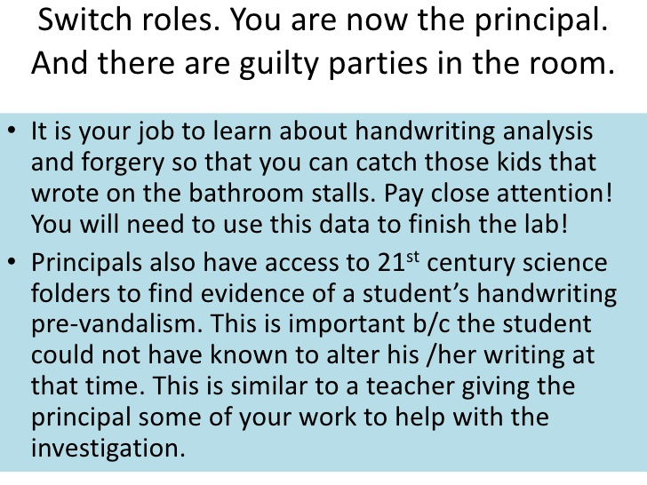

Slide 12
Please get your notes out as well

Slide 15
Your job
You now should have a #2 page in front of you.
It is your job to match it (writing on the stalls) to its owner’s writing sample (one of the #1 papers)

Slide 26
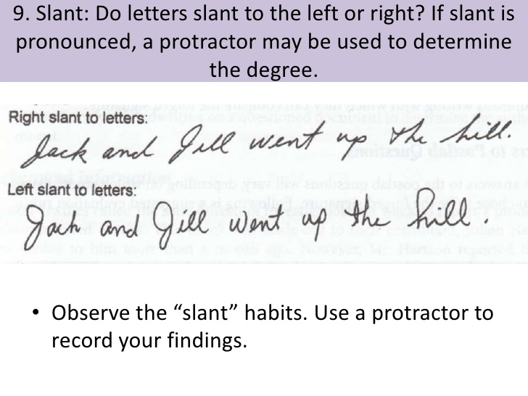

Slide 28
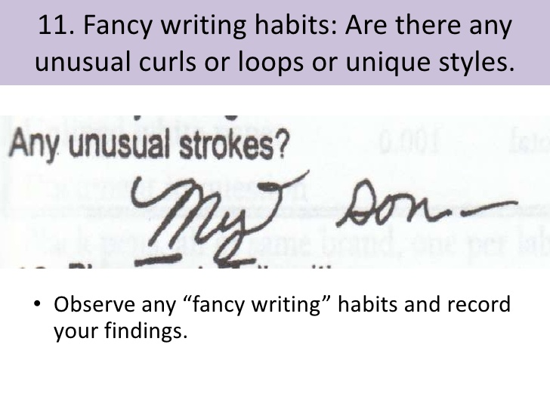

Slide 31
OKAY, back to being the Principal and finding the culprits
You have now researched one of the pieces of evidence of vandalism
Your job is to find the student responsible for it!
Please place any notes you took about the evidence to the vandalism and write your name on it (I have paper clips!)

Slide 32
Time to Investigate
Student work samples will be placed around the room
Bring your evidence and student sample to Ms. Smith ONLY WHEN YOUR ARE 100% sure you found the culprit.

Slide 33
2. What does your writing say about you

Slide 35
3. Forgery
Forgery: is the process of making, adapting, or imitating objects, statistics, or documents with the intent to deceive or make usually large amounts of money by selling the forged item
→ We will be looking at forgery in handwriting

Slide 36
Forgery
Many times criminals will try and forge a signature on a cheque in order to steal money

Slide 37
Lets see if we have any good forger’s in our class
You will get a piece of paper with 6 rows.
Please do your signature in the space where is says one
You would then pass it to the person beside you and they would try and forge your signature. They would fold the paper so it is still only the original signature showing and pass it to the next person

