Slide 1


Identifying shoeprints

Slide 2

Footprints…Shoe Prints
Things you can learn from shoe prints:
The type of shoes someone was wearing
The direction the person was going
Whether the person walked in an unusual way or if they were running
Can sometimes tell the person’s approximate height and weight

Slide 3
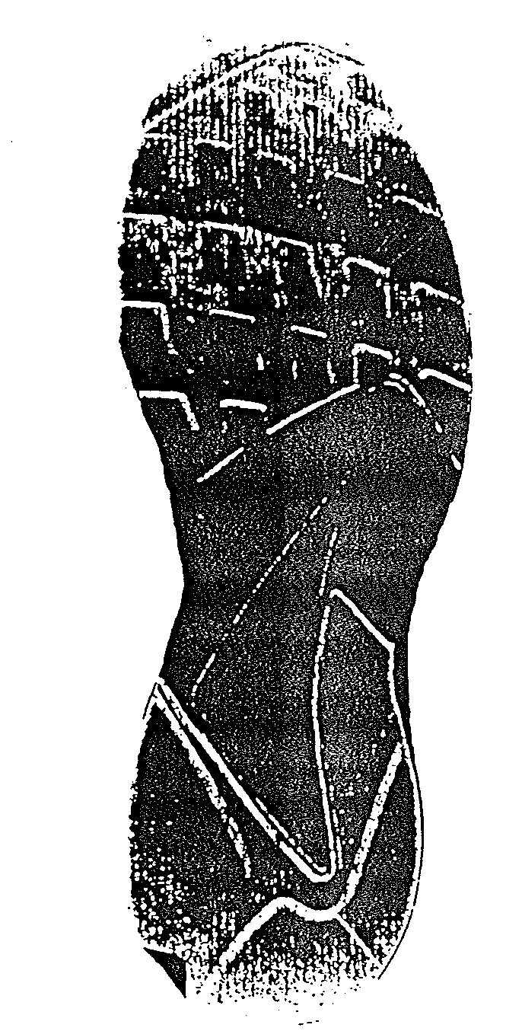
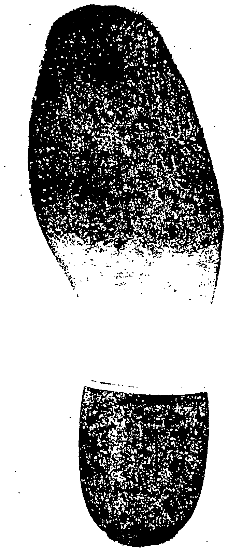
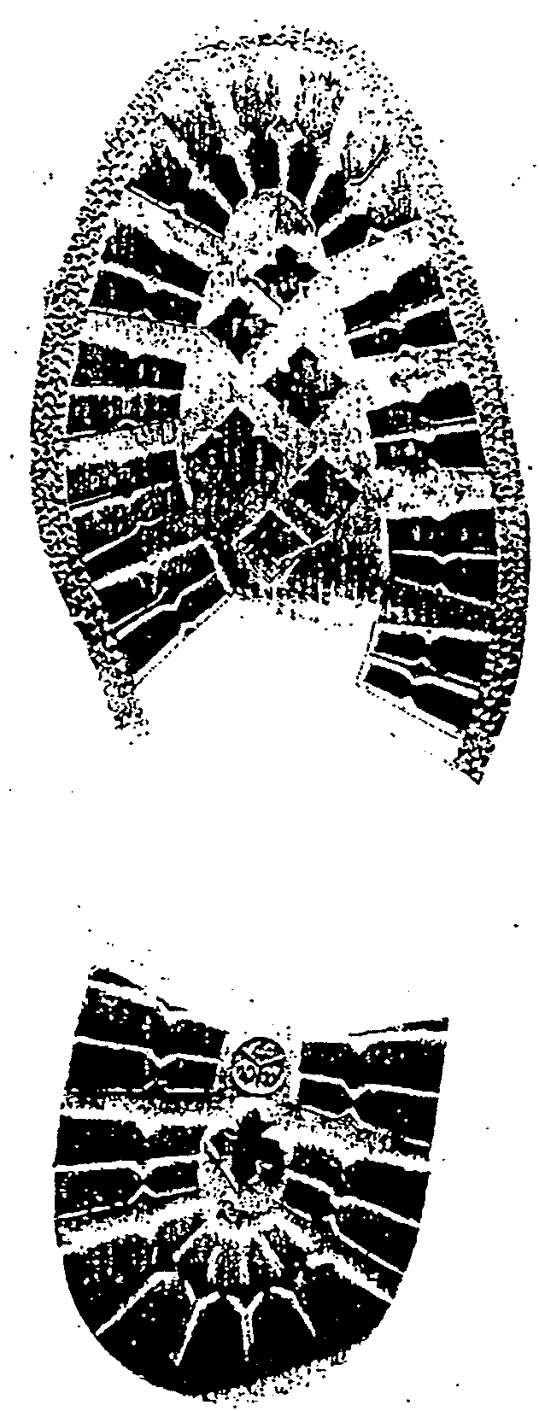
Shoe Print can be classified by…
Size
Shape
Tread pattern
Distinguishing characteristics
Cuts and marks

Slide 4
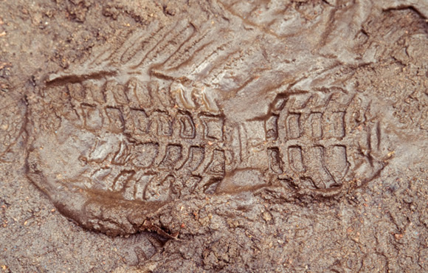
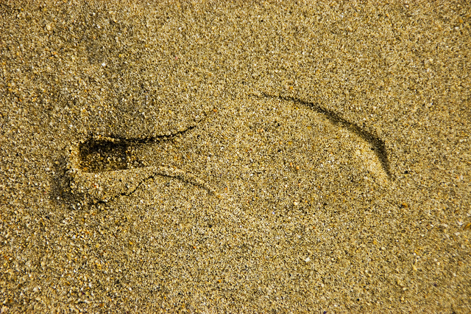
Looking at the tread
A shoe print can help investigators decide what type of shoe it was that left the print

Slide 5
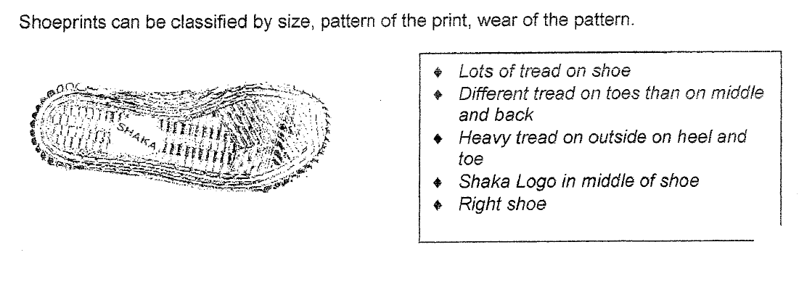
Identifying Treads

Slide 6
Lets check our treads out!
1. Take both shoes off
2. Record in your notes at least 6 characteristics of your shoe treads
3. If you can, try and infer about why it looks the way it does
(ex. walk with more weight on your toes)
Characteristics of my shoe tread
1.
2.
3.
4.
5.
6.

Slide 7
Game Time
1. You need one shoe
2. You need a piece of white paper and a crayon
3. You need to get your tread onto the paper
4. You must use the SIDE OF THE CRAYON

Slide 8
What story do footprints tell?

Slide 9
Footprints…Shoe Prints
Things you can learn from shoe prints:
The type of shoes someone was wearing
The direction the person was going
Whether the person walked in an unusual way or if they were running
Can sometimes tell the person’s approximate height and weight

Slide 10
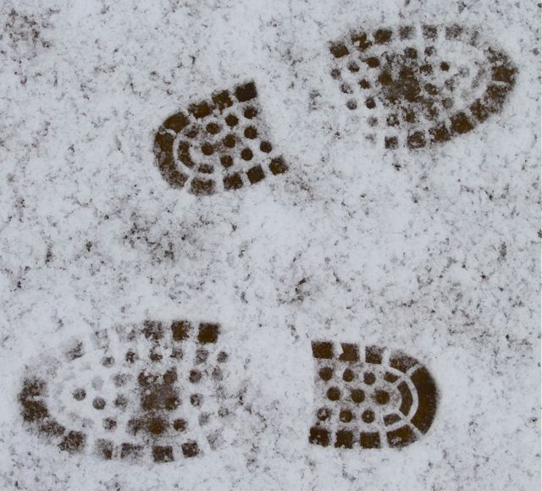
Direction
Looking at the direction of the shoeprints and the depth of the shoeprints can help investigators figure out which direction the person was going

Slide 11
Spacing in the prints
Looking at the spacing between the shoeprints can tell investigators if the person was running (large space) or walking (smaller space)

Slide 12
Evidence of Shoeprints- Running
The length of stride changes
Distribute weight over feet in a different way.
The heels of your shoe tend to go deeper into the sand, dirt, or snow when you run.

Slide 13
Walking and Running Differences
Walking
Running
Smaller spaces between prints
Shallower prints
Outline clearer
Less of a straight line (more parallel)
Large space between prints
Deeper prints
Outline may not be as clear (dirt kicked up)
Line of prints are straighter (not as parallel)

Slide 14
If The Shoe Fits
You can figure out the approximate height of someone by measuring the size of his or her shoes.
What you need:
-a ruler or measuring tape
-a pencil and paper
Press you shoe into soft sand or soil so that it leave an impression.
Measure the length of the shoe print in cm.
Divide this number by 15 and multiply it by 100. This calculation should be close to the person’s height.

Slide 15
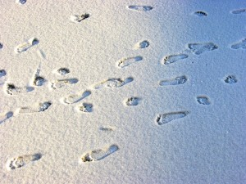
Clues in The Shoes
Interpret the shoe prints and tell a story about what happened in the print.

Slide 16
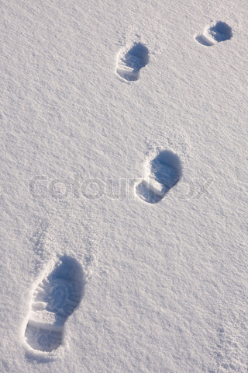
Clues in The Shoes
Interpret the shoe prints and tell a story about what happened in the print.

