Slide 1
Streamlining

Slide 2
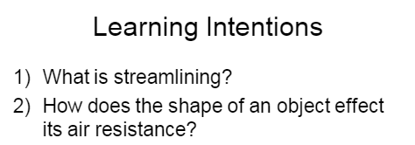

Slide 5
Drag

Slide 7
Man made vs. Living Things
Man Made Objects | Living Things

Slide 9
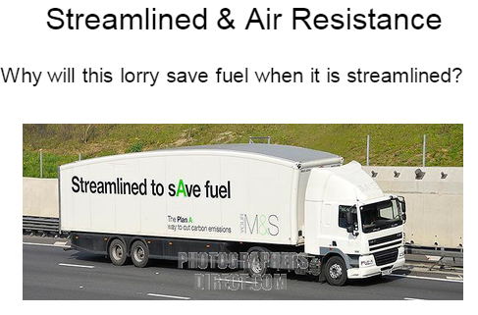

Slide 10
Testing Streamlining, Air Resistance, and Drag

