Slide 1
Moons On Other Planets

Slide 2
The “top 7” moons in the solar system
Satellite | Planet | Diameter(km) | Mass (relative to Moon)
Ganymede | Jupiter | 5262 | 2.03
Titan | Saturn | 5150 | 1.83
Callisto | Jupiter | 4820 | 1.46
Io | Jupiter | 3640 | 1.21
Moon | Earth | 3476 | 1.00
Europa | Jupiter | 3122 | 0.66
Triton | Neptune | 2700 | 0.29

Slide 3
Moons
What are moons?
Moons are like little planets that encircle the real planets
Usually are much smaller than planets
Planets can have no moons (like Mercury and Venus), one moon (like Earth) or up to a very large number of moons (e.g. 63 for Jupiter).

Slide 4
Moons
Phobos and Deimos
Phobos and Deimos are Mars‘ companions. Phobos means “fear“, Deimos means “panic“
Mars itself has been named for the Roman God of War.
They are quite small (<15km) and look rather like potatoes than like moons.

Slide 5
Virtually nothing was known about the Moons of Jupiter prior to the arrival of spacecraft in the 1970s
Io
Europa
Ganymede
Callisto
8 others known before space age
A total of 63 now known (mostly tiny)

Slide 6
Moons
Io, Callisto, Ganymed and Europa
These four moons are the biggest moons of Jupiter
They can be seen with small telescopes or even with binoculars
Io
Europa

Slide 7
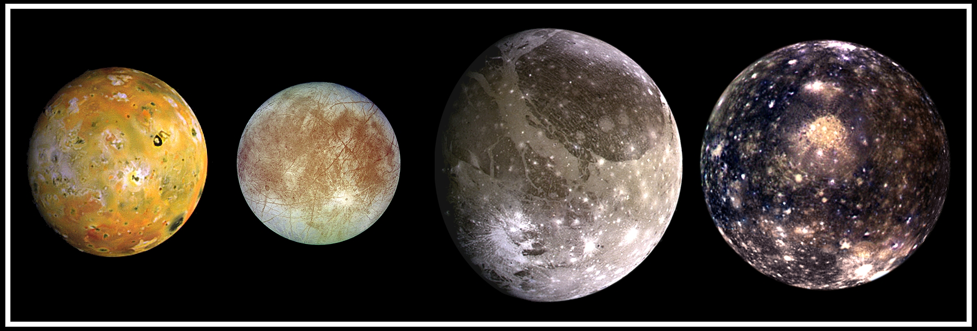
The Galilean satellites of Jupiter

Slide 8
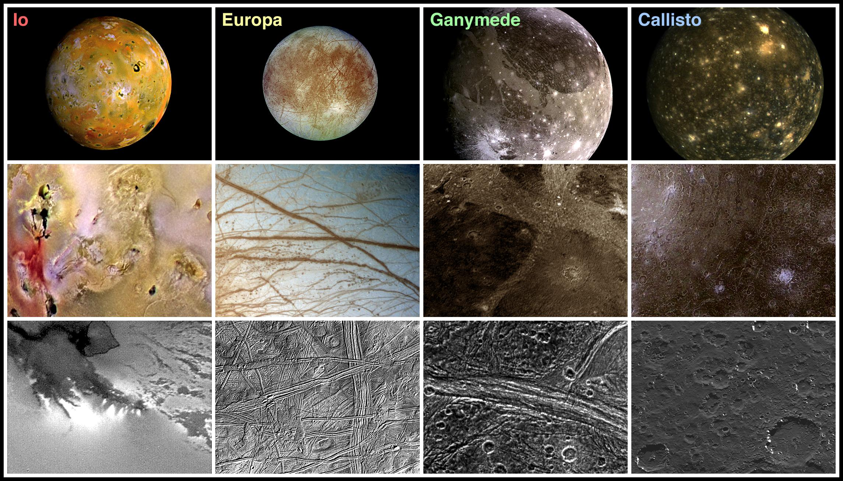
The Galilean satellites of Jupiter (cont)

Slide 9
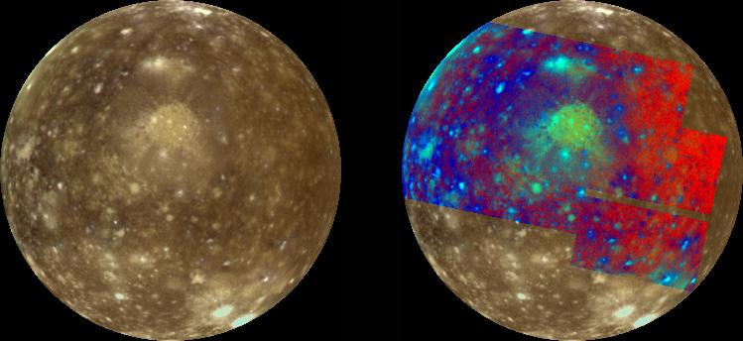
Callisto: most distant of Galilean satellites
Distance from Jupiter = 1883 thousand km; diameter = 4820km

Slide 10
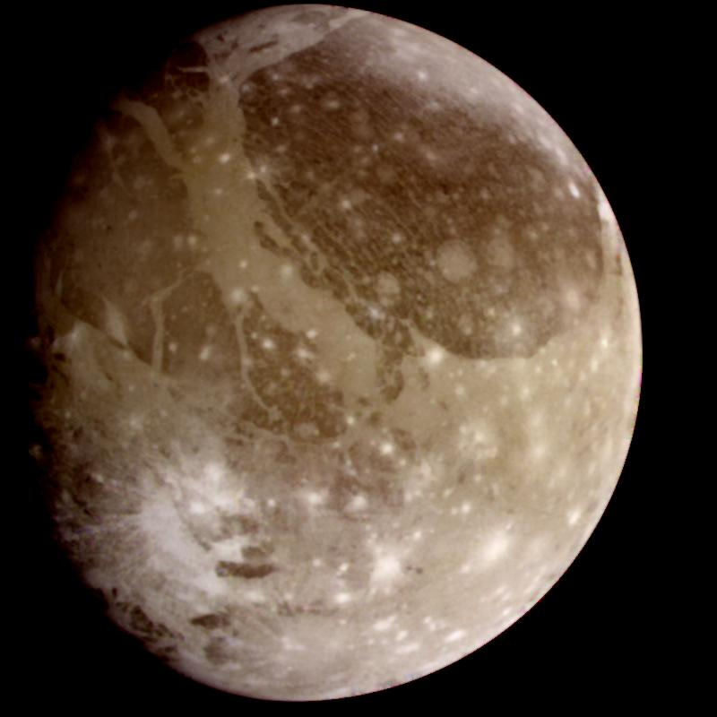
Ganymede: largest moon in solar system
Distance from Jupiter = 1080 thousand km, diameter = 5262

Slide 11
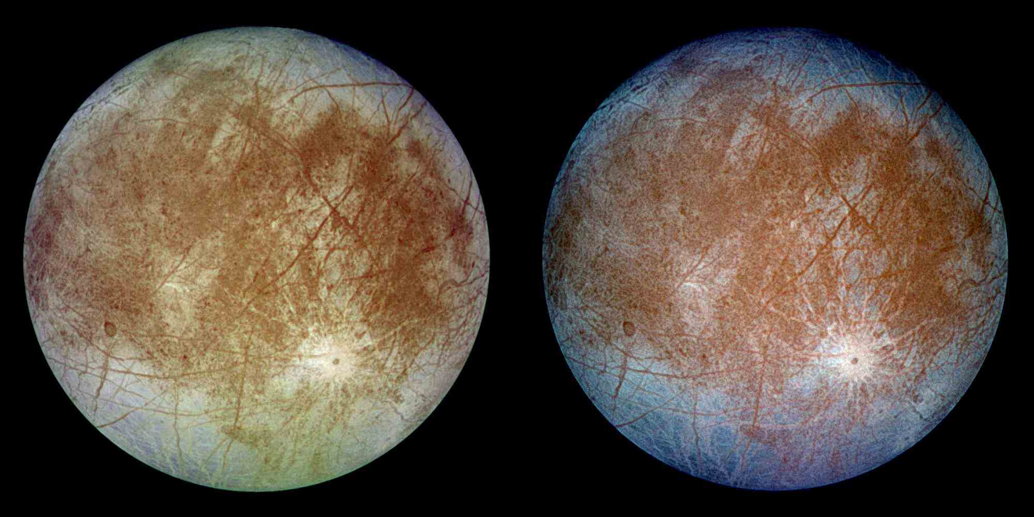
Europa
Distance from Jupiter = 671 thousand km, diameter = 3122 km

Slide 12
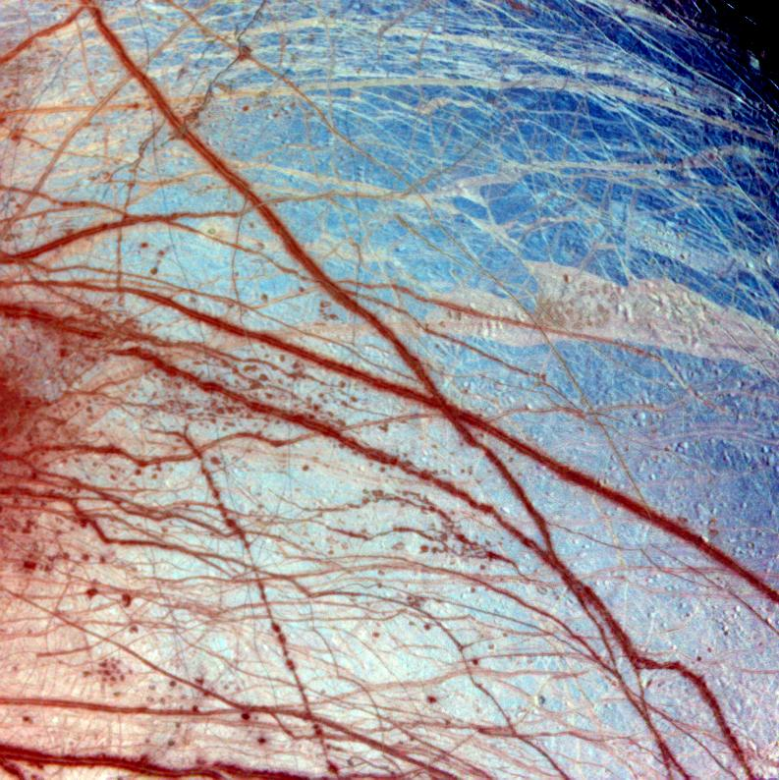
Cracks in the ice crust of Europa
Evidence of water flows from the interior

Slide 13
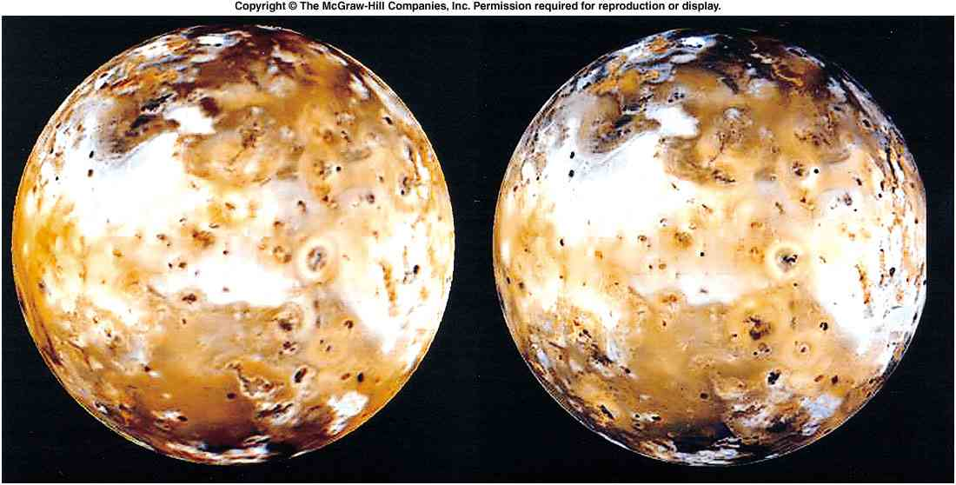
Changes on Io: 1979-1999

