Slide 1
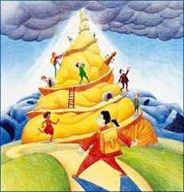
The Theory of Multiple Intelligences

Slide 2
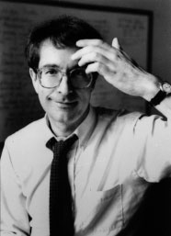
The Who and What of Multiple Intelligences
Created in 1983 by Howard
Suggested that there is an array of different kinds of intelligences
Notes:
*
It expands our horizon of available teaching/learning tools beyond the conventional linguistic and logical methods lecture, textbooks, writing assignments, formulas)

Slide 3
8 Identified Intelligences
Linguistic
Logical-Mathematical
Spatial
Bodily-Kinesthetic
Musical
Interpersonal
Intrapersonal
Naturalistic

Slide 4
Verbal Linguistic Intelligence
Deals with words, spoken and written
Reading, writing, telling stories, and memorizing words and dates.
Learn best: Reading, taking notes, & listening to lecture
Notes:
Deals with words, spoken and written
People with this intelligence are usually good at reading, writing, telling stories, and memorizing words and dates.
Learn best through reading, taking notes, and listening to lectures
*

Slide 5
Verbal Linguistic Intelligence
Skilled in explaining, teaching, and persuasive speaking
They learn foreign languages easily
Writers, politicians, & teachers

Slide 6
Verbal-Linguistic
Enjoys writing, reading, and speaking
Example: A Sporty Letter
Pair up with someone in your class. Pretend your partner has never heard of your favorite sport. Write your partner a letter describing your sport, then trade letters.

Slide 7
Logical-Mathematical Intelligence
Logic, abstractions, inductive and deductive reasoning, and numbers
Usually excel in math, chess, computer programming, and other logical or numerical activities.
Scientists, mathematicians, lawyers, doctors, and philosophers

Slide 8
Math-Logic
Activities: Putting things in order, graphing, working out puzzles, & problem solving.
Example: Compare and Contrast
Compare and contrast soccer and football. Write all the things unique to soccer in the soccer box. Write all the things unique to football in the football box. Write all things in common in the intersection.

Slide 9
Spatial Intelligence
Vision and spatial judgment
Visualizing and mentally manipulating objects.
Strong visual memory, artistically inclined, good sense of direction, and good hand-eye coordination
Artists, engineers, and architects
Notes:
Deals with vision and spatial judgment
Usually very good at visualizing and mentally manipulating objects.
Have a strong visual memory, artistically inclined, good sense of direction, and good hand-eye coordination
Good careers include, artists, engineers, and architects
*

Slide 10
Spatial Intelligence
Working with pictures, maps, diagrams
Example: Describe the Castle
Describe a picture of a castle the best you can. When done, cut the castle out and hide it. Give your paper to your partner. He or she will attempt to draw the castle from your description. When done, compare castles and discuss how the description could have been better.

Slide 11
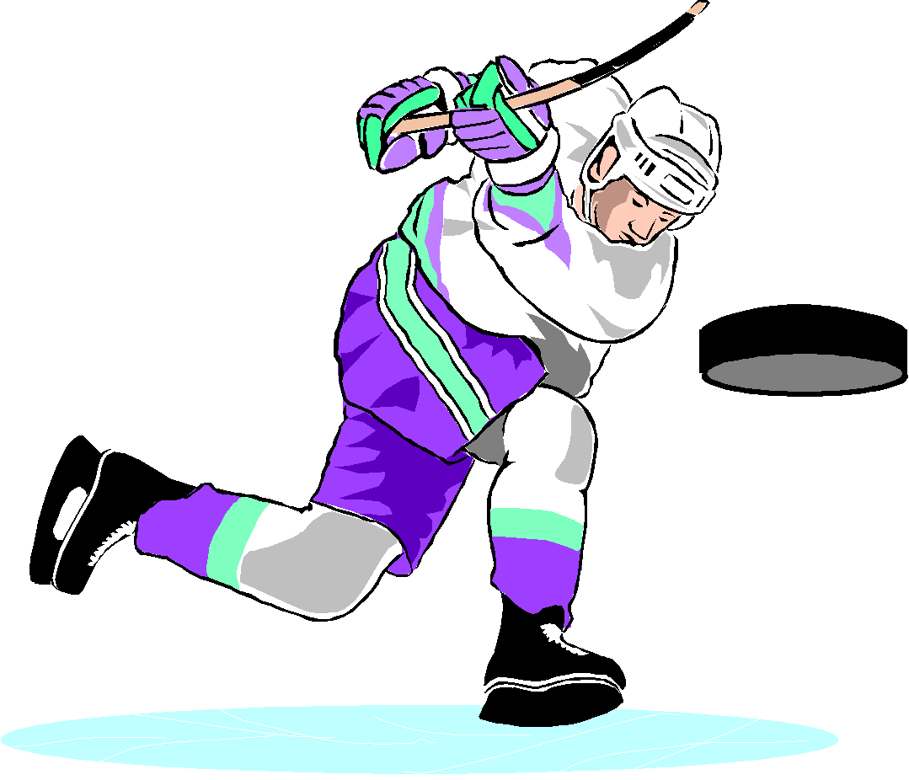
Bodily-Kinesthetic Intelligence
Movement and doing things.
Excel in physical activities, like dance and sport.
They may enjoy acting or performing.
Notes:
Deals with movement and doing things.
Generally excel in physical activities
Dance and sports
Often prefer activities which utilize movement
They may enjoy acting or performing
*

Slide 12
Bodily-Kinesthetic Intelligence
Often learn best by physically doing something, rather then reading or hearing about it.
Use “muscle memory” (remember things through their body, not through words or images)
Good careers include, athletes, dancers, actors, comedians, builders, and artisans

Slide 13
Bodily-Kinesthetic Intelligence
Learning through moving and 'making and doing' things
Example: Act It Out!
Pick one of your vocabulary words and take turns acting out your words. See if teammates can guess which word you are acting out. See if you can guess the words your teammates are acting out.

Slide 14
Musical Intelligence
Rhythm, music, and hearing.
Greater sensitivity to sounds, rhythms, tones, and music.
Good pitch, maybe even absolute pitch
Able to sing, play instruments, and compose music
Notes:
Deals with rhythm, music, and hearing.
Tend to have a greater sensitivity to sounds, rhythms, tones, and music.
Have good pitch and may even have absolute pitch
Able to sing, play musical instruments, and compose music
*

Slide 15
Musical
Creating and listening to rhythms, music, dance
Example: The Antonym Song
Work with a partner to write a song about antonyms to the tune of “Jingle Bells”. Sing your song to another pair.

Slide 16
Naturalistic Intelligence
Nature, nurturing, and classification.
Greater sensitivity to nature and their place within it
Ability to nurture and grow things
Caring for, taming, and interacting with animals
Notes:
Deals with nature, nurturing, and classification.
Greater sensitivity o nature and their place within it
Have the ability to nurture and grow things
Greater ease in caring for, taming, and interacting with animals
*

Slide 17
Naturalistic Intelligence
This is the newest of the intelligences
Not as widely accepted
Good careers include, scientists, naturalists, conservationists, gardeners, and farmers
Notes:
Deals with nature, nurturing, and classification.
Greater sensitivity o nature and their place within it
Have the ability to nurture and grow things
Greater ease in caring for, taming, and interacting with animals
*

Slide 18
Naturalist
Exploring nature, using natural materials, caring for the environment
Example: The Spotted Horse
Write a creative story about the spotted horse.

Slide 19
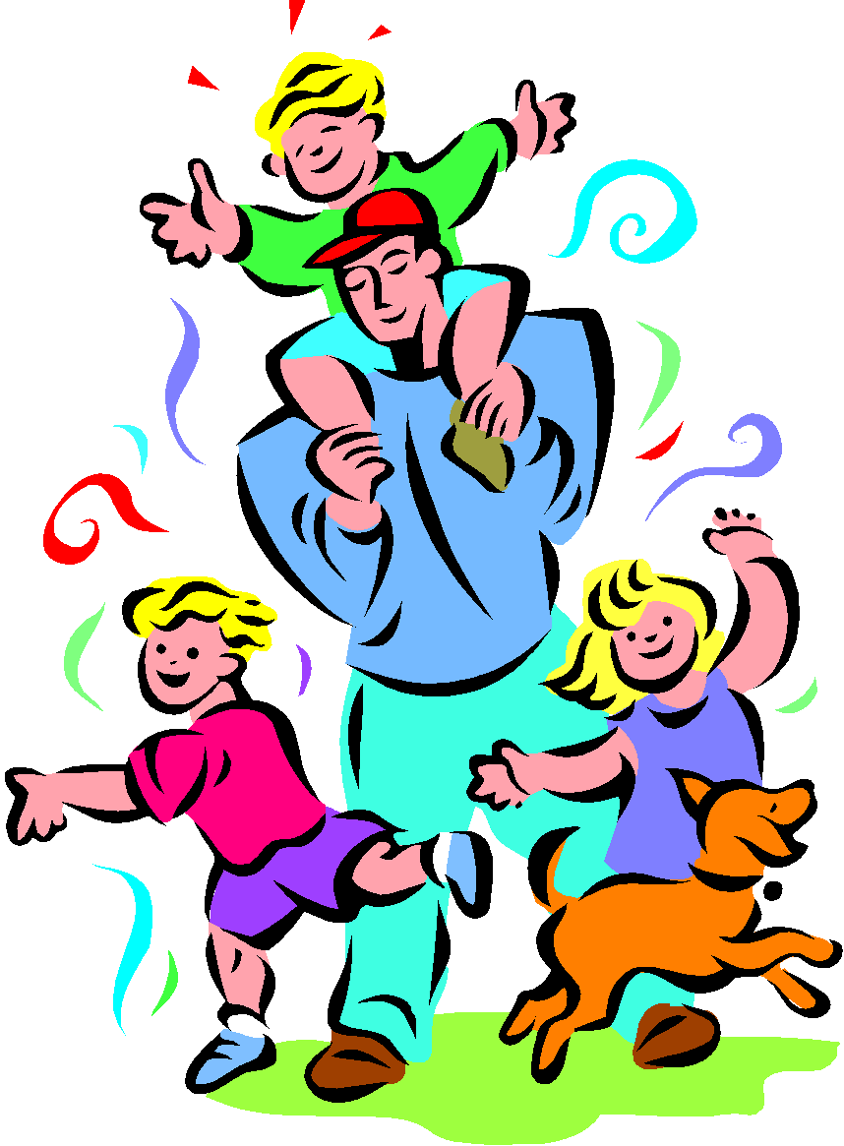
Interpersonal Intelligence
Deals with the interaction with others
Usually extroverts
Sensitivity to others’ moods, feelings, temperaments, and motivations
Able to cooperate in order to work as a member of a group

Slide 20
Interpersonal Intelligence
Communicate effectively
Empathize easily with others
Can be a leader or a follower
Learn best by working with others with discussion and debate
Good careers include, politicians, managers, social workers, and diplomats.

Slide 21
Interpersonal Intelligence
Working with other people
Example: Building Relations
Work with a partner to write connections between two seemingly different objects. Take turns writing your answers. Compare your answers with another pair.

Slide 22
Intrapersonal Intelligence
Deals with oneself.
Usually introverts
Prefer to work alone
Highly self-aware
Can understand their own:
Emotions
Goals
Motivations

Slide 23
Intrapersonal Intelligence
Learn best when allowed to concentrate on the subject by themselves.
High level of perfectionism with this intelligence
Philosophers, psychologists, theologians, & writers

Slide 24
Intrapersonal
Working alone, goal setting, focusing on your own learning
Example: Making analogies
Write how you are like the shapes below (circle, triangle, square, pentagon). Share your answers with a teammate.

