Slide 1
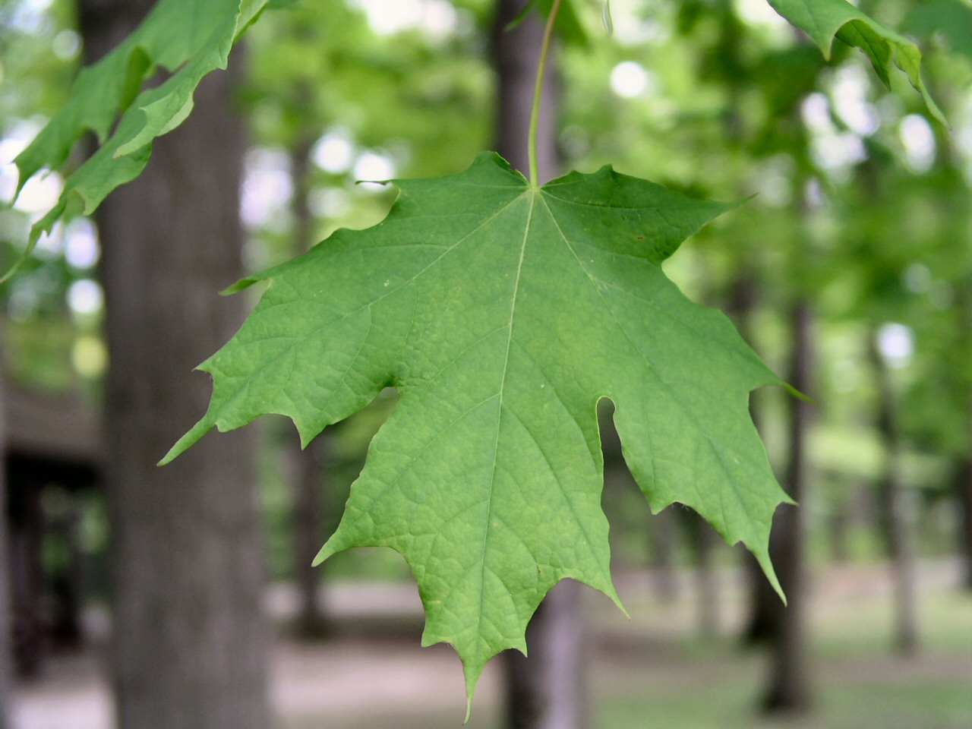
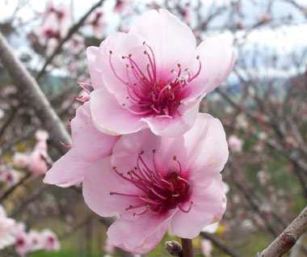
Leaf Identification,
Life Cycles, Flowers,
Fruits
Leaf Identification

Slide 2
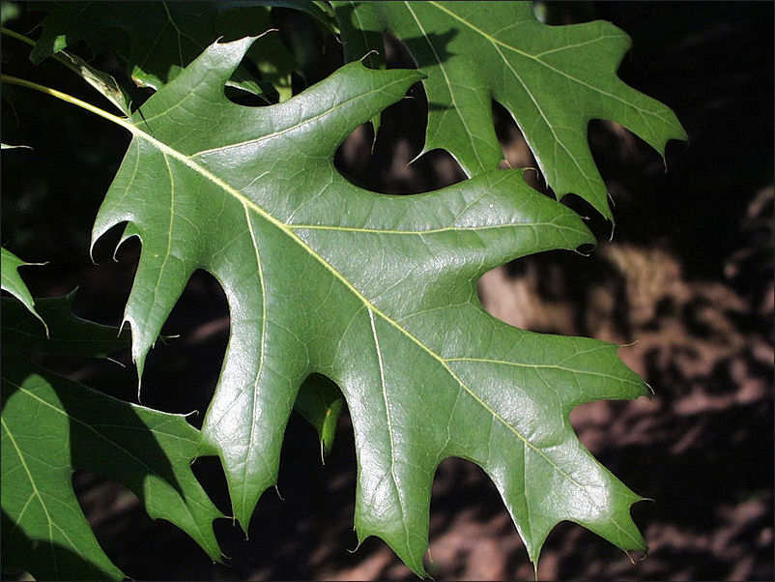
Activity! Please describe the leaf below.
Copyright © 2010 Ryan P. Murphy

Slide 3
Answer! It’s green and round.
Copyright © 2010 Ryan P. Murphy

Slide 4
Answer! It’s green and round.
Copyright © 2010 Ryan P. Murphy

Slide 5
Answer! It’s green and round.
“That description is vague. We need specifics.”
Copyright © 2010 Ryan P. Murphy

Slide 6
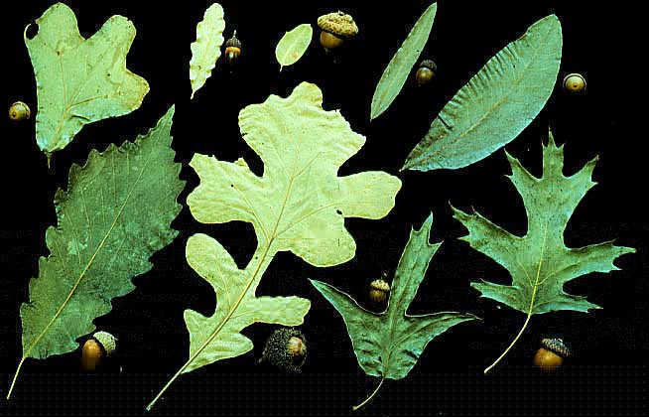
Leaves need to be identified based on a series of different criteria.
Copyright © 2010 Ryan P. Murphy

Slide 7
Leaves need to be identified based on a series of different criteria. There are thousands and thousands of types of plants,
Copyright © 2010 Ryan P. Murphy

Slide 8
Leaves need to identified based on a series of different criteria. There are thousands and thousands of types of plants, and most are green.
Copyright © 2010 Ryan P. Murphy

Slide 9
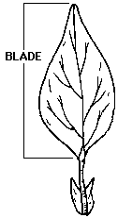
Blade: The entire leaf unit. Sometimes this is made up of several smaller leaflets.
Copyright © 2010 Ryan P. Murphy

Slide 10
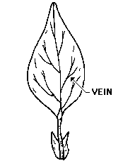
Veins: Contain vascular tissues.
Copyright © 2010 Ryan P. Murphy

Slide 11
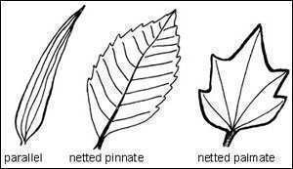
Three basic types of leaf venation.
Copyright © 2010 Ryan P. Murphy

Slide 12
Three basic types of leaf venation.
Copyright © 2010 Ryan P. Murphy

Slide 13
Three basic types of leaf venation.
Copyright © 2010 Ryan P. Murphy

Slide 14
Three basic types of leaf venation.
Copyright © 2010 Ryan P. Murphy

Slide 15
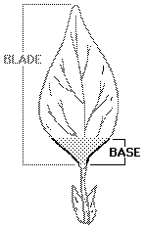
Leaf Base: Name for the blade close to the stem
Copyright © 2010 Ryan P. Murphy

Slide 16
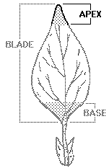
Leaf Apex: The tip of the leaf.
Copyright © 2010 Ryan P. Murphy

Slide 17
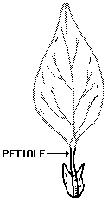
The Petiole: Thin stalk that connects the leaf blade to the stem.
Copyright © 2010 Ryan P. Murphy

Slide 18
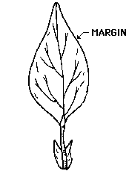
Leaf Margin: The edge of the leaf.
Copyright © 2010 Ryan P. Murphy

Slide 19
Leaf Margins
The shape of the edge or margin of a leaf is another way it can be identified. Three kinds of margins are Entire, Toothed, and Lobed.

Slide 20
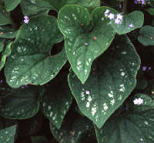
Entire
Smooth no bumps

Slide 21
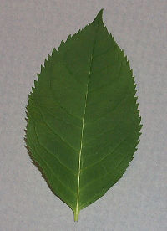
Toothed
Shallow bumps

Slide 22
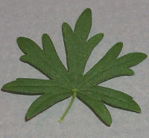
Lobed
deep indents or sinuses

Slide 23
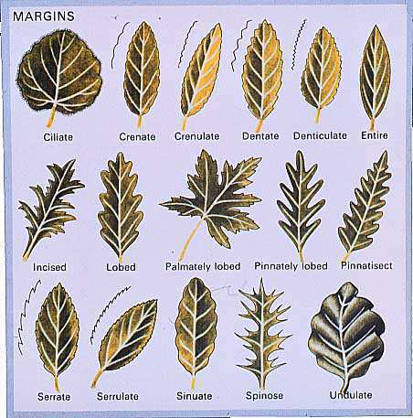
Which leaf margin is your leaf?
Copyright © 2010 Ryan P. Murphy

Slide 24
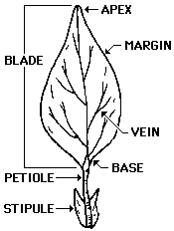
Review! Describe each word below on or around your leaf.
Describe your leaf so someone else could identify it without seeing it.
Copyright © 2010 Ryan P. Murphy

Slide 25
Review! Describe each word below on or around your leaf.
Describe your leaf so someone else could identify it without seeing it.
Copyright © 2010 Ryan P. Murphy

Slide 26
Is your leaf Simple or Compound?
Copyright © 2010 Ryan P. Murphy

Slide 27
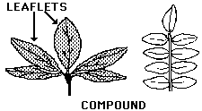
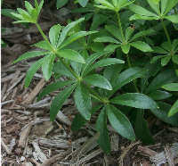
Compound Leaves: They appear in groups and are made up of leaflets.
Copyright © 2010 Ryan P. Murphy

Slide 28
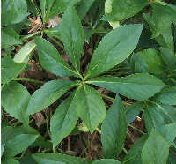
Compound Leaves
Palmate: Leaflets form fan shape.
Copyright © 2010 Ryan P. Murphy

Slide 29
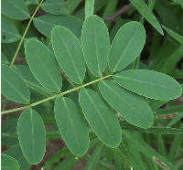
Compound Leaves
Pinnate: Leaflets are opposite each other on the stem.
Copyright © 2010 Ryan P. Murphy

Slide 30
Compound Leaves
Bipinnate: Leaflets are in pairs of pinnate groups.
Copyright © 2010 Ryan P. Murphy

Slide 31
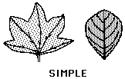
Simple Leaf: They appear alone.
Copyright © 2010 Ryan P. Murphy

Slide 32
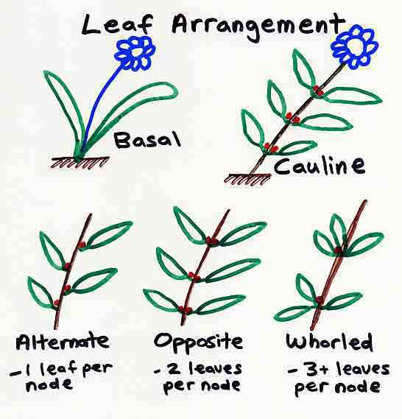
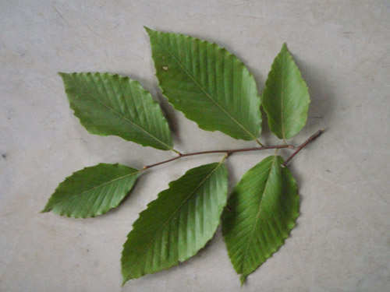
Does your leaf fit any of these for leaf arrangement?
Copyright © 2010 Ryan P. Murphy

Slide 33
Now identify leaf types
Next set of slides.
Copyright © 2010 Ryan P. Murphy

Slide 34
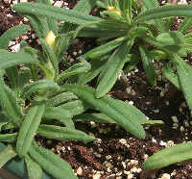
Which leaf type fits your leaf?
Linear:
Copyright © 2010 Ryan P. Murphy

Slide 35
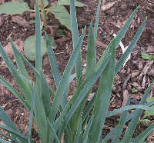
Lanceolot: Lance shaped, spear point.
Copyright © 2010 Ryan P. Murphy

Slide 36
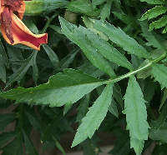
Oblong: Much longer than wide, with nearly parallel sides.
Copyright © 2010 Ryan P. Murphy

Slide 37
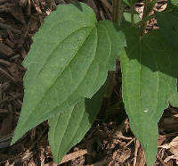
Ovate: Egg-shaped, broader at the base than the tip
Copyright © 2010 Ryan P. Murphy

Slide 38
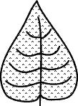
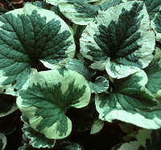
Chordate: Heart-shaped, either the leaf shape or base.
Copyright © 2010 Ryan P. Murphy

Slide 39
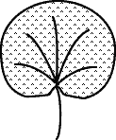
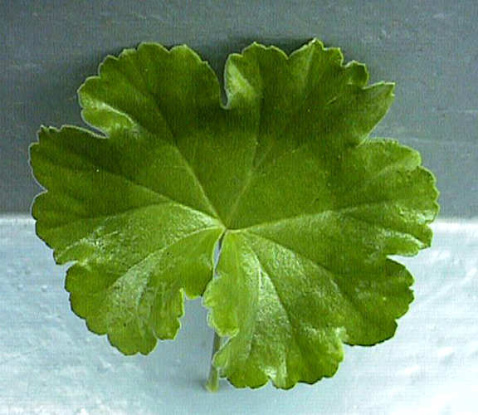
Reniform: Kidney Shaped.
Copyright © 2010 Ryan P. Murphy

Slide 40
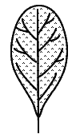
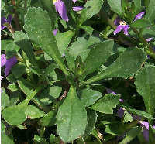
Spatulate: Shaped like a spoon or spatula.
Copyright © 2010 Ryan P. Murphy

Slide 41
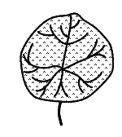
Orbicular: Round
Copyright © 2010 Ryan P. Murphy

Slide 42
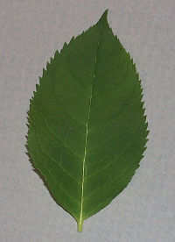
Elliptic: Shaped like an ellipse, wider at the center and tapering to equal tips
Copyright © 2010 Ryan P. Murphy

