Slide 1
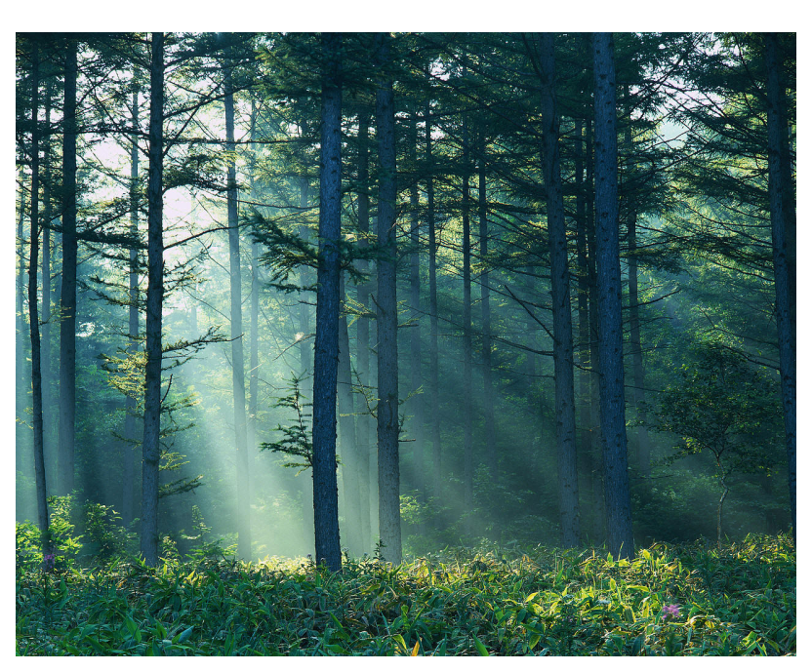
Forest Ecosystem Balance

Slide 2
In a forest, every organism is interconnected.
Everything in the forest is important for its survival.

Slide 3
Forest Team Members
Producers:
Plants are called producers. This is because they produce their own food!
Consumers:
Animals are called consumers. This is because they cannot make their own food, so they need to consume (eat) plants and/or animals.
Decomposers:
Bacteria and fungi are decomposers. They eat decaying matter - dead plants and animals and in the process they break them down and decompose them

Slide 4
EXAMPLES
Producers: clover, cones, rosehips, raspberry bush, acorn bush, tree (or varieties of trees), grass, flower nectar, etc.
Consumers: rabbit, robin, beaver, owl, hawk, fox, squirrel, hummingbird, deer, coyote, mouse, bear, etc.
Decomposers: earthworm, bacteria, fungus, maggots, etc.

Slide 5
Types of Consumers
primary consumer - the first consumer to eat the producer
secondary consumer - a consumer which eats the first consumer
tertiary consumer - a consumer which eats the second consumer

Slide 6
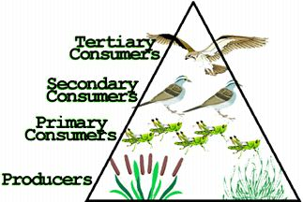

Slide 7
Putting it all together

Slide 8
Food Chains
One way the forest is interconnected is through a food chain or food web.

Slide 9
Food Chain
A food chain shows the flow of energy through a series of organisms.
Each organism is food for the next higher organism.

Slide 11
Food Chains of Alberta Forests
1. | grass → deer mouse | →weasel | →coyote
2. | aspen leaves → caterpillar | → oriole | → sharp-shinned hawk

Slide 12
Food Web
A more complex version of a food chain
Many food chains connected together

Slide 13
Food Web

Slide 14
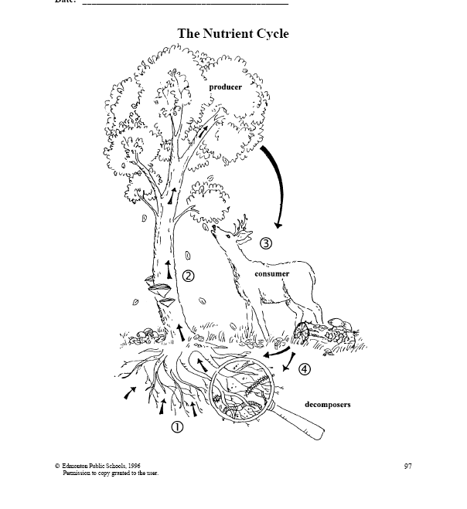
Nutrient Cycle
Nutrients in the soil are absorbed by tree roots.
Nutrients travel up the trunk to the leaves.
Leaves fall to the ground or are eaten by the consumers.
Decomposers break down dead plant or animal matter and return the nutrients to the soil, where the cycle begins again.
Notes:
*Give the students a copy of Master #5 and have them write the 4 steps onto the sheet itself.

Slide 15
Nutrient Cycle
Consumers
*get nutrients from
plants and animals
Decomposers
*get nutrients from dead plant and animal material
*return nutrients to the soil
Producers
*get nutrients
from the soil

