Slide 1
The Sun!!

Slide 2
What did you learn yesterday about the sun?

Slide 3
Sun Spots
Sunspots are storm-like occurrences on the Sun's surface.
They are about 1000˚c cooler than the Sun’s surface so they appear darker than the hotter and brighter area around them.
Over a period of several days, sunspots would appear to change position because they are moving. An average sunspot is about the size of earth.

Slide 4
Lets take a closer look at the sun
Video:

Slide 5
Looking at the Sun
The sun in the closest star to the Earth.
The light from the sun is so bright that looking at the Sun without proper eye protection will permanently damage the eyes.
It only takes 3 seconds to cause permanent eye damage! There are no pain receptors in the retina of the eye so there is no pain to warn us of the damage being done.

Slide 6
What about cloudy day?
Cloudy days are not safe either because of ultraviolet rays. The sun can be viewed indirectly with the use of certain devices

Slide 7
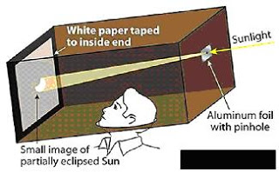
Pin Hole Camera

Slide 8
What is a pin hole camera?
A pinhole camera is a simple camera without a lens and with a single small aperture (opening), a pinhole – effectively a light-proof box with a small hole in one side.
Light from a scene passes through this single point and projects an inverted image on the opposite side of the box.

Slide 9
Pin Hole Camera
Procedure:
Cut a 5 cm square out of one end of a shoebox.
Cover with a piece of tin foil. Tape into place making sure the tin foil is flat.
Poke a small hole in the center of the tin foil with a pin.
Place a sheet of white paper on the inside of the box at the opposite end.
To view, hold the box above your head with the pinhole facing toward the eclipse.
You will face the screen with your back to the eclipse. An upside down image will form on the screen.

Slide 10
Movement of the Sun

Slide 11
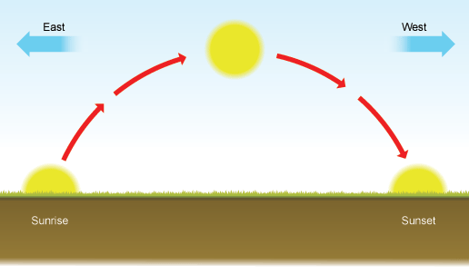
Sun’s Movement
Sun rises in the East: In the morning the Sun is low in the East
As the Earth rotates the Sun appears to move across the sky.
Sun sets in the West: As the Earth continues to rotate the Sun appears to move to the West

Slide 12
What causes these changes?
The rotation of the earth causes the sun to appear to move across the sky.
Remember, the sun doesn’t actually move!
https://www.youtube.com/watch?v=IuJwl5nIzGE

Slide 13
Galileo’s ideas
The apparent movement is due to the Earth's rotation and can be explained in the fashion the Galileo used to explain why he thought the Earth went around the sun as opposed to the Sun going around the Earth.
When you stand on shore and watch a boat pull away you think that the boat is moving away from the shore, but the shore could be moving away from the boat.
Or you may have had is sitting in a car stopped at the lights. As the car next to you moves forward and even though you are stopped you have the sensation that you are moving backwards.

Slide 14
What keeps the planets moving around the Sun? Or the Moon around the Earth? Why Don’t the planets fall into the Sun, or fly off into space?
Objects in space attract one another with a force known as Gravity.
The sun, for example, pulls the planets toward it with a gravitational force that gets stronger as you approach the sun.
However, the planets also pull the sun towards them, but this pull is not as effective because the planets are so much less massive than the sun.

Slide 15
The planets do not fall into the sun because of their tremendous orbital speed.
This velocity balances the gravity of the sun so that the planets are forced to move in near−circular orbits around the sun.
The same applies to moons moving around a planet.

