Slide 1
Planets!

Slide 2
LEARNING OBJECTIVES
Understand that the Earth, the Sun and the Moon are part of a solar system that only occupies only a tiny part of the known universe.
Recognize that the other eight known planets, which revolve around the Sun, have characteristics and surface conditions that are different from Earth, and identify examples of those differences.

Slide 3
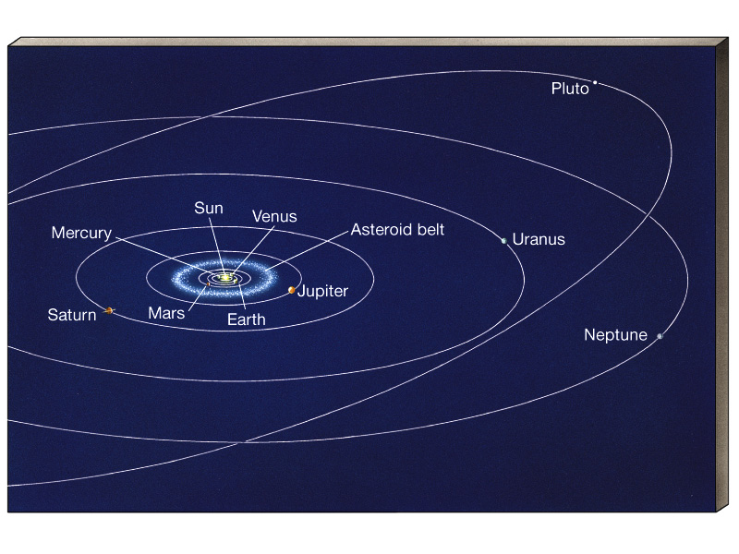
The Solar System
1 star
9 8 planets
63 (major) moons
asteroids, comets, meteoroids

Slide 4
What are the 8 Planets in our Solar System??
Mercury
Venus
Earth
Mars
Jupiter
Saturn
Uranus
Neptune
Pluto??

Slide 5
Why Pluto is no longer a planet....
It needs to be in orbit around the Sun - Yes, so maybe Pluto is a planet.
It needs to have enough gravity to pull itself into a spherical shape - Pluto…check
It needs to have "cleared the neighbourhood" of its orbit - Uh oh. Here's the rule breaker. According to this, Pluto is not a planet.

Slide 6
Continued...
What does "cleared its neighbourhood" mean? As planets form, they become the dominant gravitational body in their orbit in the Solar System. As they interact with other, smaller objects, they either consume them, or sling them away with their gravity. Pluto is only 0.07 times the mass of the other objects in its orbit. The Earth, in comparison, has 1.7 million times the mass of the other objects in its orbit.
Any object that doesn't meet this 3rd criteria is considered a dwarf planet. And so, Pluto is a dwarf planet. There are still many objects with similar size and mass to Pluto jostling around in its orbit. And until Pluto crashes into many of them and gains mass, it will remain a dwarf planet.

Slide 7
Mercury
Closest planet to our Sun
Named for the ancient Roman god of trade and profit. (Legend says Mercury’s winged sandals gave him super speed.)
FAST!
It travels very fast around the Sun. Once every 88 Earth days. Rotation period (length of day in Earth days) 58.65
It is the second smallest planet in our Solar system (It is only slightly larger than the Earth's moon).
The surface is covered with craters.
This tiny planet does not have any rings or moons.
Atmosphere: mainly helium

Slide 8
Planet Mercury

Slide 9
VENUS
Second planet from the sun
Very hot!! 482 degrees Celsius
Because its dense could cover reflects sunlight, Venus is brightest object in the sky (except for the sun and moon)
It rises and sets with the Sun each day
Only planet that rotates in a clockwise direction
Like the moon Venus has phases.
Revolution: It takes 224.7 earth days to go around the sun
Rotation period (length of day in Earth days) 243.02
Atmosphere: Carbon dioxide, and its upper clouds, sulfuric acid.

Slide 10
Ancient civilizations believed Venus was
actually two different objects,
so they called the one that rose the
Morning Star, and the one that set
the Evening Star.
Venus

Slide 11
EARTH
Third planet from the sun
Largely composed of rock and metal
Only planet we know of that contains life
Circular orbit, receives a steady flow of heat and light from the Sun.
Earth has one satellite, the moon, and an abundance of water.
Takes 365.25 days to go around the sun

Slide 12
EARTH

Slide 13
MARS
Fourth planet from the sun
About half the size of Earth
It takes 1.88 years to orbit around the Sun
Atmosphere: thin, and like Earth it has seasons.
Mars has polar ice caps and 2 moons: PHOBOS AND DEIMOS
Rotation period (length of day in Earth days) 1.026
Revolution period (length of year in Earth days) 686.98

Slide 14
It was named after
the Roman god of war because its reddish color reminded the people of blood
MARS

Slide 15
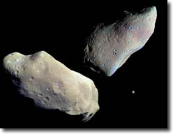
ASTEROID BELT
Most asteroids can be found in the Asteroid Belt, which is located between
Mars and Jupiter. Asteroids are rocky and metallic objects that orbit the Sun,
but are too small to be considered planets. They are known as minor planets.
Asteroids range in size from Ceres, which has a diameter of about 1000 km,
down to the size of pebbles.
Notes:
Asteroids are sometimes called Minor planets. They are small rocky bodies.
They are made up of leftover material from our solar system.
Largest asteroid 1 Ceres Total discovered to date Over 250,000 designations have been assigned by the Minor Planet Center; over 100,000 have been observed more than once. Total numbered asteroids to date.Over 30,000. Near-Earth asteroids Around 1.0 AU from earth, with perihelia less than or equal to 1.3 AU.

Slide 16
JUPITER
Jupiter, the fifth planet from the Sun and it is also the Largest planet in the solar system
Known for its GREAT RED SPOT (it is actually a storm system and it is three times the size of Earth)
Jupiter is so big that over 1,000 planets the size of Earth could fit into it.
It has over 60 moons and 2 rings
Atmosphere: alternating light and dark belts composed of gases moving at high speeds in opposite directions.
Rotation period (length of day in Earth days) 0.41 (9.8 Earth hours)
Revolution period (length of year in Earth years) 11.86
16 moons: Io one of Jupiter’s moons contains extraterrestrial volcanoes.

Slide 17
No one knows for sure who discovered Jupiter, but we know the ancient Greeks named it after the god, Zeus.
JUPITER

Slide 18
SATURN
Saturn, the sixth planet from the Sun, and it is the second largest planet in our solar system.
It is often called the ringed planet because it has beautiful rings of boulders, pebbles and ice.
Saturn also has around 50 moons (remember moons are just natural satellites), largest is Titan, it is bigger than planet Mercury
Rotation period (length of day in Earth days) 0.44 (10.2 Earth hours)
Revolution period (length of year in Earth years) 29.46
Made up of mostly of gases and is so light it could float on water.

Slide 19
The ancient Greeks named the planet after the god of agriculture and time. It wasn't until 1655, however, that we knew Saturn had rings. Galileo saw them, but he didn't know what they were. Another astronomer, Christian Huygens, later discovered they were rings.
SATURN

Slide 20
URANUS
Seventh planet from the sun
Greenish in color
15 moons and 11 faint rings
Uranus is a very unusual planet because it sits on its side with north and south poles sticking out the sides Atmosphere is made up of mostly methane gas.
Uranus is the farthest planet that can be seen without a telescope
Rotation period (length of day in Earth days) 0.72 (17.9 Earth hours)
Revolution period (length of year in Earth days) 30,685 (84 Earth years)

Slide 21
Astronomer William Herschel discovered Uranus in 1781. Using a telescope, he spotted a dim object. He watched it for years and decided it had to be a planet given its orbit.
URANUS

Slide 22
NEPTUNE
Eight planet from the sun
Slightly smaller than Uranus
Has 8 moons
Atmosphere is similar to that of Uranus, its bluish color comes from its atmosphere of methane gas.
Has storm activity like Jupiter’s atmosphere.
Rotation period (length of day in Earth days) 0.67 (19.1 hours)
Revolution period (length of year in Earth days) 60,190 (164.8 Earth years)

Slide 23
Neptune wasn't discovered the way all the other planets in our solar system were found. Astronomers didn't scan the sky with their powerful telescopes to find Neptune. They used math instead!
After the discovery of Uranus, astronomers were having trouble figuring out Uranus’ orbit. They realized that there must be another planet farther out than Uranus because this unknown planet’s gravitational pull slightly changes Uranus' orbit. They were right! French astronomer Leverrier and English astronomer John Couch Adams made the mathematical calculations of where Neptune should be in 1843, and German astronomer Johann Galle found it in 1846.
NEPTUNE

Slide 24
The terrestrial planets are the four innermost planets in the solar system, Mercury, Venus, Earth and Mars.
They are called terrestrial because they have a compact, rocky surface like the Earth's. The planets, Venus, Earth, and Mars have significant atmospheres while Mercury has almost none.

Slide 25
The Jovian Planets
Jupiter, Saturn, Uranus, and Neptune are known as the Jovian (Jupiter-like) planets, because they are all gigantic compared with Earth, and they have a gaseous nature like Jupiter's. The Jovian planets are also referred to as the gas giants, although some or all of them might have small solid cores.

Slide 26
Terrestrial Planets
Jovian Planets
Mercury, Venus, Earth and Mars
Close to Sun
Small masses, radii
Rocky, solid surfaces
High densities
Slow rotation
Weak magnetic field
No rings
Few moons
Jupiter, Saturn, Uranus, and Neptune
Far from Sun
Large masses and radii
Gaseous surface
Low densities
Fast rotation
Strong magnetic field
Many rings
Many moons

Slide 27
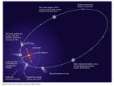
COMETS
Comets are sometimes called dirty snowballs or "icy mudballs".
They are a mixture of ices (both water and frozen gases) and dust that for
some reason didn't get incorporated into planets when the solar system was formed.
This makes them very interesting as samples of the early history of the solar system.
Comets have
elliptical orbits.
When we see a comet, we
are seeing the tail of the comet
as comes close to the Sun.
Comet Halley in 1910
Notes:
Comets are icy planetesimals formed in the outer solar system.
They are composed mainly ice and dust
They have highly elliptical orbits which take them very close to the Sun and back out into deep space, often far beyond the orbit of Pluto. Their orbit duration can be from less than 200 years to more than several millions of years.
Composition of comets:
Nucleus- Main body of the comet: composed of dust particles trapped in a mixture of ices of water, carbon monoxide, carbon dioxide, methane, and ammonia. Typically only a few kilometers in diameter
Coma- A halo of evaporated gas and dust which forms when the comet approaches the inner solar system. The coma grows larger as the comet gets closer to the sun.

Slide 28
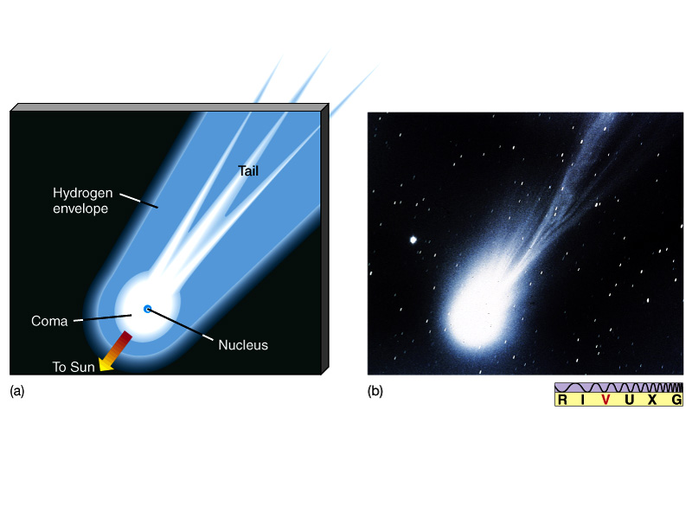
Comets
Dirty snowballs - dust and rock in methane, ammonia and ice
All light is reflected from the Sun - the comet makes no light of its own
Halley’s Comet in 1986
The nucleus is a few km in diameter

Slide 29
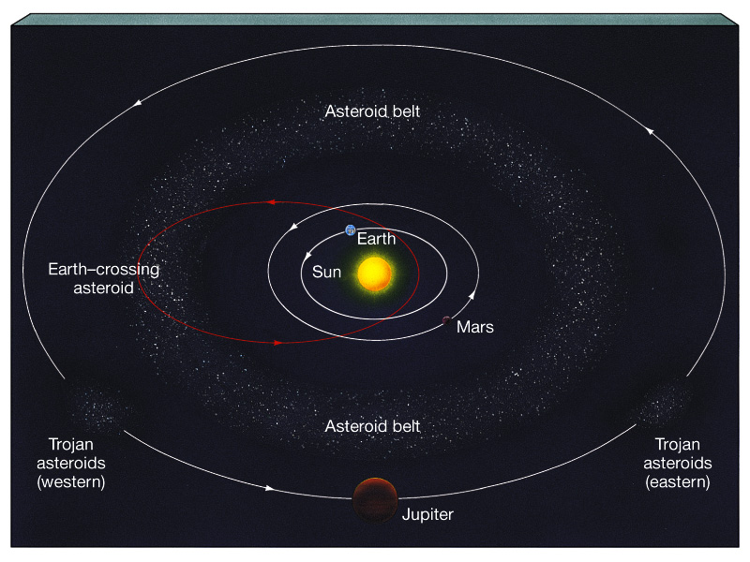
Asteroids - rocks with sizes greater than 100m across
Most asteroids remain in the Asteroid belt between Mars and Jupiter but a few have orbits that cross Earth’s path.
Three asteroids hit the Earth every 1 million years!

Slide 30
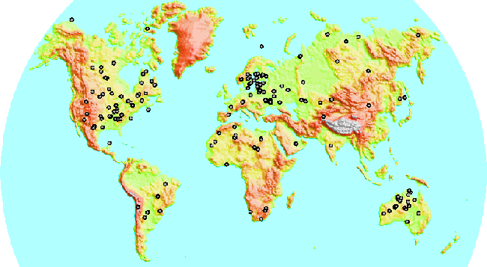
Known asteroid impact sites

Slide 31
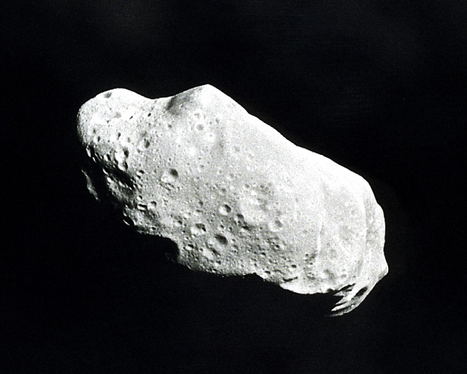
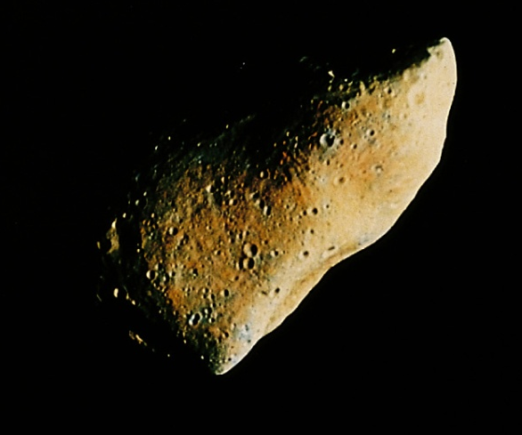
Asteroid sizes range from 100m to about 1000km
They are composed of carbon or iron and other rocky material.
The Asteroid belt is a group of rocks that appear to have never joined to make a planet. Why do we think this?
Too little mass to be a planet
Asteriods have different chemical compositions

Slide 32
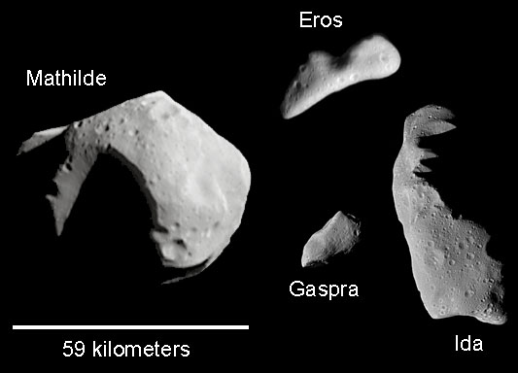

Slide 33
Meteoroids – interplanetary rocky material smaller than 100m (down to grain size).
called a meteor as it burns in the Earth’s atmosphere
if it makes it to the ground, it is a meteorite
Most meteor showers are the result of the Earth passing through the orbit of a comet which has left debris along its path

Slide 34
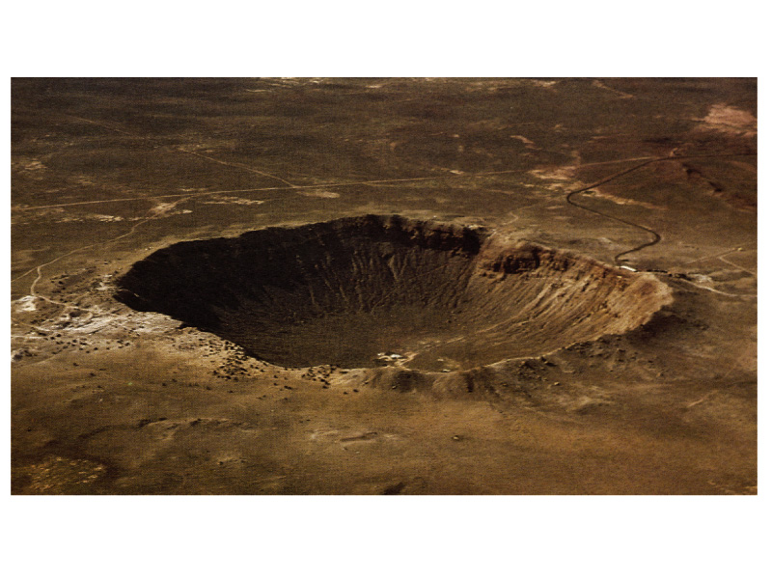
Meteors are rocky - mainly iron and nickel
Some contain carbonaceous material - rich in organic material
Meteors are old - 4.5 billion years - based on carbon dating
Meteor crater near Winslow, AZ - the culprit was probably 50 m across weighing 200,000 tons!
Meteor showers:
Orionid – Oct 21/22
Leonid – Nov 18/19
Geminid – Dec 14/15

